Slide 1
High Speed LVDS Receiver Design
In LBC9 Technology Node
Aniket Sen, Analog Intern

Slide 2
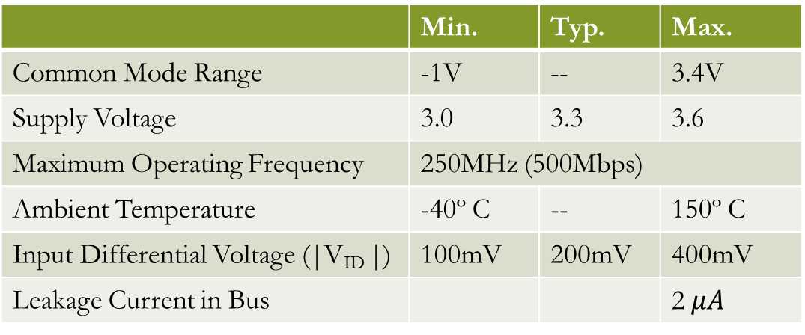
Key Specifications
 | Min. | Typ. | Max.
Common Mode Range | -1V | -- | 3.4V
Supply Voltage | 3.0 | 3.3 | 3.6
Maximum Operating Frequency | 250MHz (500Mbps)
Ambient Temperature | -40º C | -- | 150º C
Input Differential Voltage (|V_{ID} |) | 100mV | 200mV | 400mV
Leakage Current in Bus |  |  | 2$μA$
Typical common mode voltage for LVDS transmitter output is 1.2V but there is a ground variation of 2V that is considered between transmitter and receiver

Slide 3
Existing LVDS Receiver Architecture
In LBC7 technology node
Differential signal from Transmitter
Differential Rail-to-Rail Output
Attenuator Stage
Rx Comparator
Outer Buffer
Low Gain Stage
High Gain Stage
Latch
Circuit

Slide 4
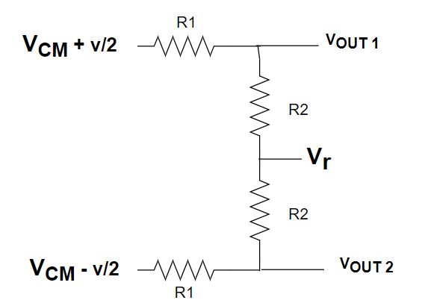
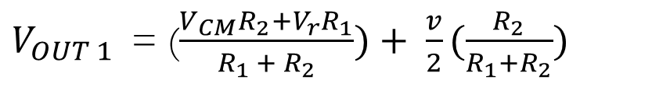
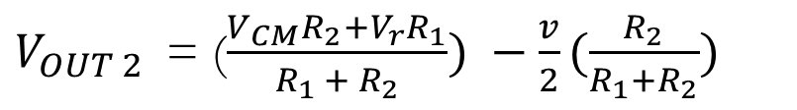
Attenuator Block Diagram
$V_{OUT 1}$= ($\frac{V_{CM}R_{2}+V_{r}R_{1}}{R_{1 }+ R_{2}})+ \frac{v}{2}(\frac{R_{2}}{R_{1}+R_{2}})$
Bus
$V_{OUT 2}$= ($\frac{V_{CM}R_{2}+V_{r}R_{1}}{R_{1 }+ R_{2}}) −\frac{v}{2}(\frac{R_{2}}{R_{1}+R_{2}})$
This is the common mode attenuation that we want from the block
The differential signal also gets attenuated

Slide 5
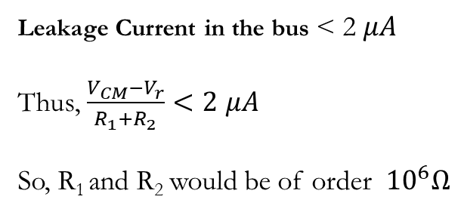
Why we require Attenuator Block ?
There is a restriction in the input DC voltage of the low gain amplifier block so that all the transistors are in saturation. So, we attenuate the input signal first to the desired range.
Leakage Current in the bus < 2$μA$
Thus, $\frac{V_{CM}−V_{r}}{R_{1}+R_{2}}<2$ $μA$
So, R₁ and R₂ would be of order ${10}^{6}Ω$
How to choose the value of R₁ and R₂ ?
If we know the attenuation required, we would get the value of R₁ / R₂ . To uniquely choose the values, we would get from the leakage current specs as the input signal to the attenuator block is directly connected to the bus channel.

Slide 6
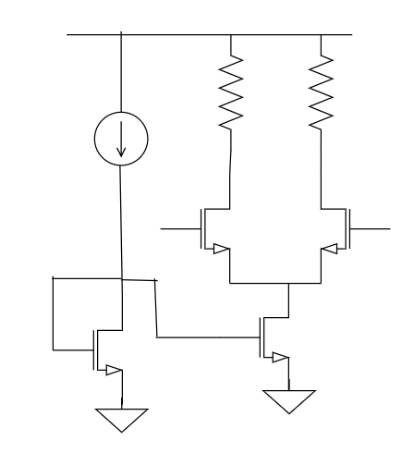


Low Gain G_{m}R Stage
To maintain the I/2, if we decrease our gate voltage of M₂ , then the source V_{s} would also decrease to make V_{GS} constant of M₂ . Thus, there we get a lower limit on our input voltage.
Also, if we keep increasing our gate voltage of M₂ , then after a certain increase, the condition of saturation gets failed : V_{DS} > V_{GS} – V_{tn} as the V_{d} is fixed due to constant current.
R
R
I
Differential Output
V_{d}
M₂
M₃
Differential Input
( V_{CM} )
I/2
V_{s}
I
$V_{ov|M1}+V_{ov|M2}+V_{tn}$< V_{CM} < $V_{cc} − \frac{IR}{2}+V_{tn}$
M₁
Gain = $\frac{IR}{V_{ov}}$

Slide 7
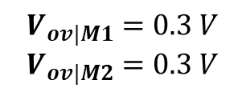
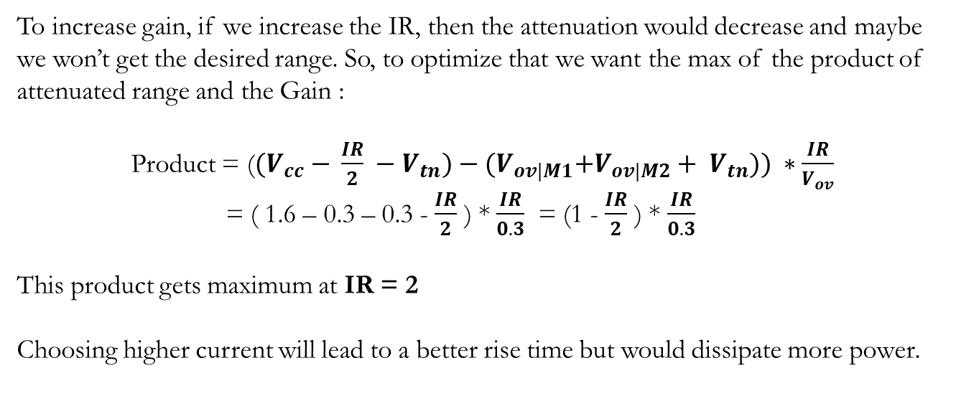
Effect of Attenuation and Gain
To increase gain, if we increase the IR, then the attenuation would decrease and maybe we won’t get the desired range. So, to optimize that we want the max of the product of attenuated range and the Gain :
Product = (${(V}_{cc} − \frac{IR}{2} −V_{tn})−{(V}_{ov|M1}+V_{ov|M2}+ V_{tn})) ∗\frac{IR}{V_{ov}}$
= ( 1.6 – 0.3 – 0.3 - $\frac{IR}{2}$ ) * $\frac{IR}{0.3}$ = (1 - $\frac{IR}{2}$ ) * $\frac{IR}{0.3}$
This product gets maximum at IR = 2
Choosing higher current will lead to a better rise time but would dissipate more power.
$$V_{ov|M1}=0.3 V$$
$$V_{ov|M2}=0.3 V$$
This is a quadratic in IR !

Slide 8
Problems of Attenuation Block
Too much RC compensation required for flattening out the frequency response.
Node capacitors are large due to high resistances used making the circuit slow.
Differential Signal also gets attenuated along with the common-mode.
This motivates to work on a new input stage architecture for receiver block that could skip the attenuator thing !
Attenuation Block

Slide 9
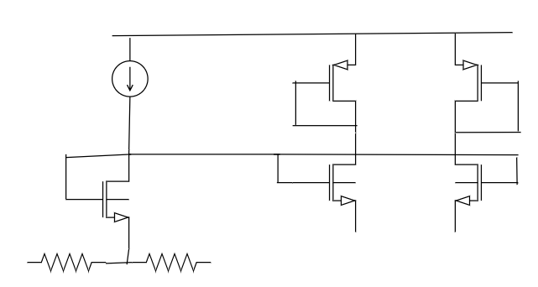
Common Gate Architecture Design
V_{dd}
The reason of diode connection would be to mirror the current which would be explained later why.
I
R₁
R₁
V_{in1}
V_{in2}
There is an error here !
V_{in1}
V_{in2}
We will not get DC common mode as there would be an I/2 current in R₁ branch that would be contributing some more potential.
Input is given directly at the Gate to make V_{GS} > V_{tn} for negative common mode also
To track V_{GS} and pushes constant current through the common gate design
To get the DC common mode

Slide 10
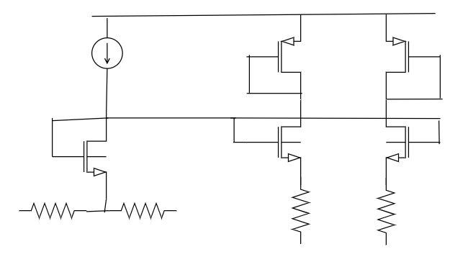
Common Gate Architecture Design
Fixing the error by adding an extra resistor R₂ to raise the source voltage.
I
nI
nI
Equating the potentials :
V_{in1} + IR₁/2 = V_{in1} + nIR₂/2
IR₁ = nIR₂
R₁ = nR₂
R₁
R₁
V_{in1}
V_{in2}
R₂
R₂
I/2
I/2
V_{in1}
V_{in2}

Slide 11
Common Gate Architecture Design
I
Gate voltage keep rising as common mode input increases
nI
nI
This voltage is fixed !
R₁
R₁
Thus, there is an upper bound to this design !
V_{in1}
V_{in2}
R₂
R₂
I/2
I/2
V_{in1}
V_{in2}

Slide 12
Common Gate Architecture Design
I
nI
nI
M₄
M₅
V_{CM} < V_{DD} - |V_{tp}|- V_{ov|M4} - V_{ov|M5}
M₁
M₂
M₃
This we would control and try to make it as small as possible
R₁
R₁
V_{in1}
V_{in2}
R₂
R₂
I/2
I/2
Now, apply similar architecture for high common mode voltage in its input
V_{in1}
V_{in2}

Slide 13
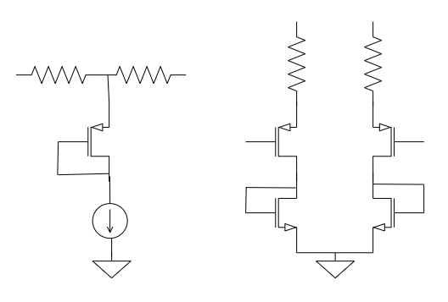
Common Gate Architecture Design
V_{in1}
V_{in2}
R₁
R₁
This would work for higher common mode voltages.
V_{in1}
V_{in2}
R₂
R₂
I/2
I/2
M₁
M₂
M₃
The limit is
V_{CM} > V_{ov|M2} + V_{ov|M4} + IR/2 + V_{tn}
nI
nI
This we would control and try to make it as small as possible
I
M₄
M₅

Slide 14
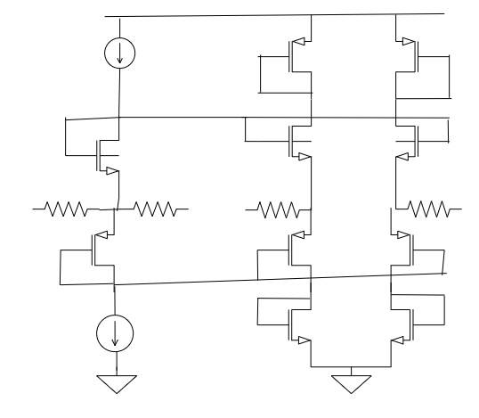
Common Gate Architecture Design
The NMOS based design
Current will be mirrored to Max current Selector Block
R₁
R₁
R₂
R₂
The PMOS based design
Current will be mirrored to Max current Selector Block

Slide 15
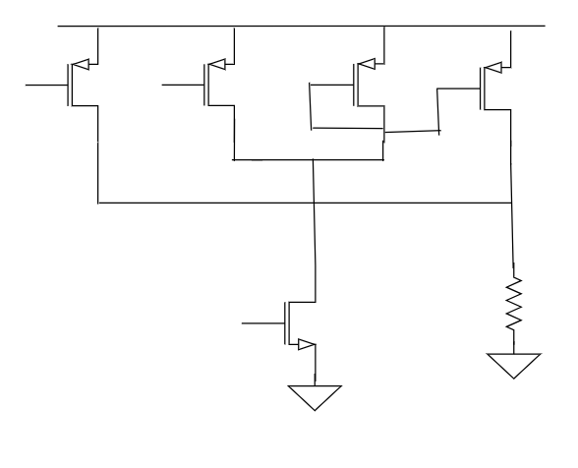
Max Current Selector Block
Maximum of I_{N} and I_{P} flows through the load R_{L}
Case 1 : I_{N} > I_{P}
The drain of M₅ is pulled up to V_{DD} such that the current from M₃ drops to zero and the M₂ goes to linear region and matches I_{p} . Thus, total current in load branch = 0 + I_{N} = I_{N} = max(I_{P} , I_{N})
Case 2 : I_{N} < I_{P}
Then I_{N1} = I_{N} and remaining (I_{P} – I_{N}) flows from the transistor M₃ which is mirrored to the M₄ branch. Thus, total current from load is (I_{P} – I_{N}) + I_{N} = I_{P} = max ( I_{P} , I_{N} )
Case 3 : I_{N} = I_{P}
Then no current flows from M₃ branch and again current from load branch is I_{N} which is max of (I_{N} , I_{P} ).
M₃
M₄
M₁
I_{N}
I_{N1}
M₂
M₅
R_{L}
I_{p}
Fig. Max Current Selector Block

Slide 16
Common Gate Architecture Design
Thus, the motive behind this block is to send the maximum current between the PMOS based and NMOS based common gate design which would be a constant current “nI” through the load covering the wide common-mode range.
This is being mirrored from the NMOS-based common gate
R_{L}
This is being mirrored from the PMOS-based common gate

Slide 17
Common Gate Architecture Design
New Architecture of Input Stage of High Speed LVDS Receiver Design
V_{DD}
V_{DD}
V_{DD}
I_{N1}
M₄
M₃
M₁₂
M₁₃
M₁₄
M₁₈
M₁₉
M₁
I_{N2}
M₁₁
I_{N1}
M₁₆
I_{N2}
M₁₇
M₅
M₆
R₁
R₁
V_{in1}
R₂
R₂
V_{in1}
V_{in2}
V_{in2}
M₁₀
M₁₅
R_{L}
M₂₀
I_{P2}
R_{L}
M₉
I_{P1}
I_{P2}
M₂
I_{P1}
M₇
M₈
V_{out1}
V_{out2}

Slide 18
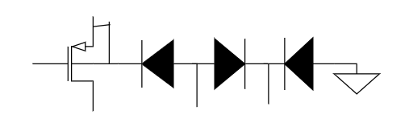
Body Connection
For removing the non-linearity of body-effect, we tied the body locally to its source. But, the negative voltage was creating some problem.
P-epi
ISO
Fig. Current leakage from body in PMOS
D₁
D₂
D₃
For D₁ to be reverse biased, we try to bias p-epi to ground but at negative common-mode voltages, the diode D₁ would become forward biased.
For D₃ to be reverse biased, ISO could be grounded or make to it AVDD

Slide 19
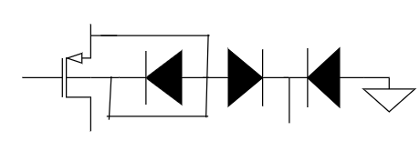
FIXATION OF THE ISSUE
SOLUTION :
Short the Body and drain to the p-epi node for not having any path for the current to flow.
Just ensure D2 and D3 to be reverse biased and that could be pretty much done by either making ISO to AVDD or GND
D₁
D₂
D₃
Remember, the objective was to get a flat gain across V_{CM} which motivated to nullify the body-source effect.
Now, D₁ is reverse-biased

Slide 20
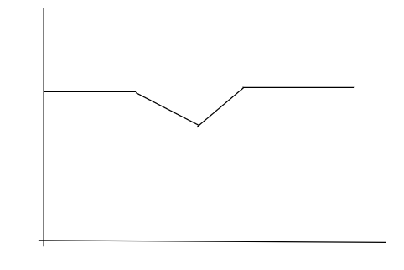

AC Gain
For lower V_{CM} :
Gain = $\frac{g_{M5}R_{L}}{1+g_{M5}R_{2}}$
For V_{CM} ~ 1.5V :
Gain = $\frac{{max⁡(g}_{M5 , }g_{M9})R_{L}}{1+{(g}_{M5}{+g_{M9})R}_{2}}$
For higher V_{CM} :
Gain = $\frac{g_{M9}R_{L}}{1+g_{M9}R_{2}}$
Design such that g_{M5} = g_{M9} for same gain at the corners
Gain
This drop could be removed if g_{M5}R₂ + g_{M9}R₂ <<1
-1V
1.5V
3.4V
V_{CM}

Slide 21
Frequency Response
V_{DD}
V_{DD}
V_{DD}
I_{N1}
M₄
M₃
M₁₂
M₁₃
M₁₄
M₁₈
M₁₉
M₁
I_{N2}
M₁₁
I_{N1}
M₁₆
I_{N2}
M₁₇
M₅
M₆
R₁
R₁
V_{in1}
R₂
R₂
V_{in2}
V_{in2}
M₁₀
M₁₅
R_{L}
M₂₀
I_{P2}
R_{L}
M₉
I_{P1}
I_{P2}
M₂
I_{P1}
M₇
M₈
V_{out1}
V_{out2}

Slide 22
THANKS

